Slide 1
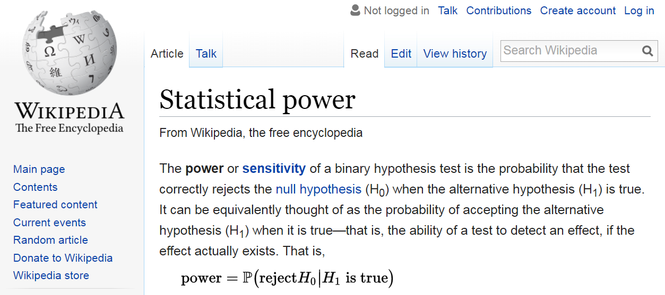

Slide 2
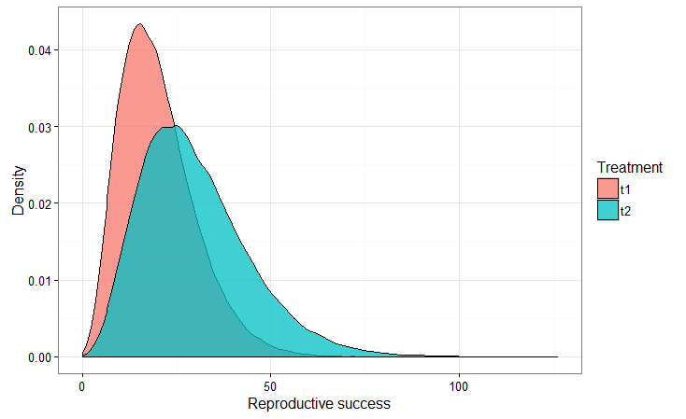
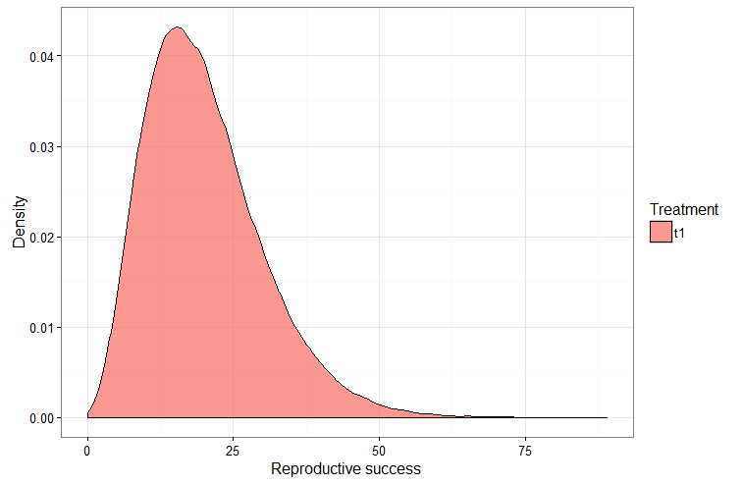
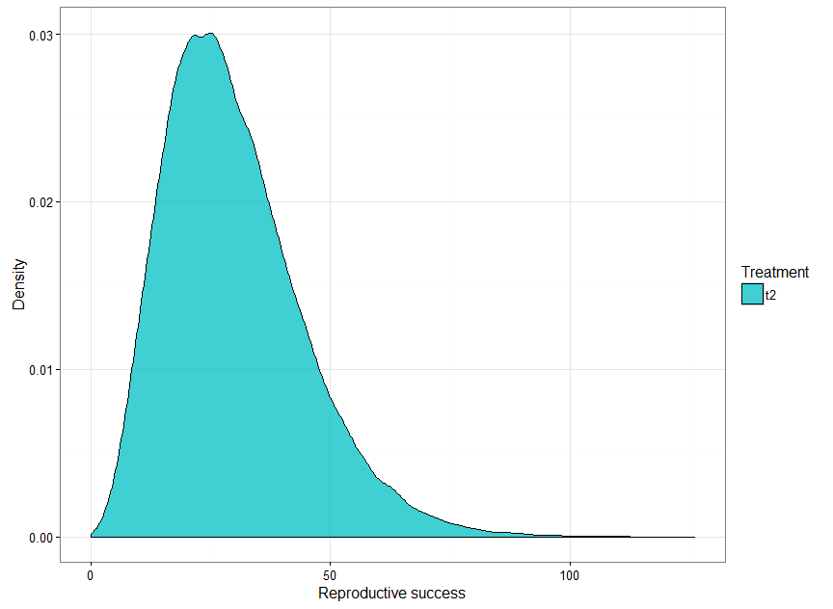
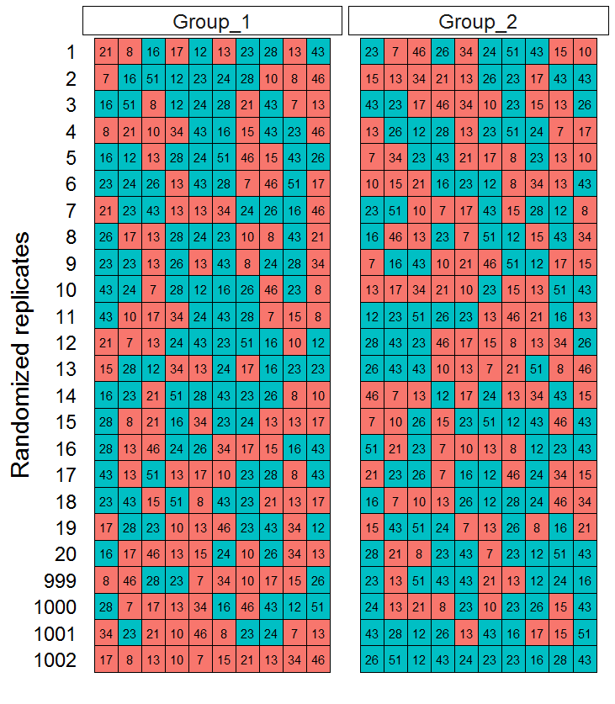
Create a scenario where samples come from two different distributions.
Draw samples from those distributions.
Real data

Slide 3
Combine both samples, randomly shuffle them, and randomly assign them into two groups. Repeat this process many times (e.g. 1000).
Decide on a test statistic. I will choose the difference between the treatment means:
Treatment mean 1 – Treatment mean 2
Calculate test statistic for randomized replicates.
…
…
…
Real data

Slide 4
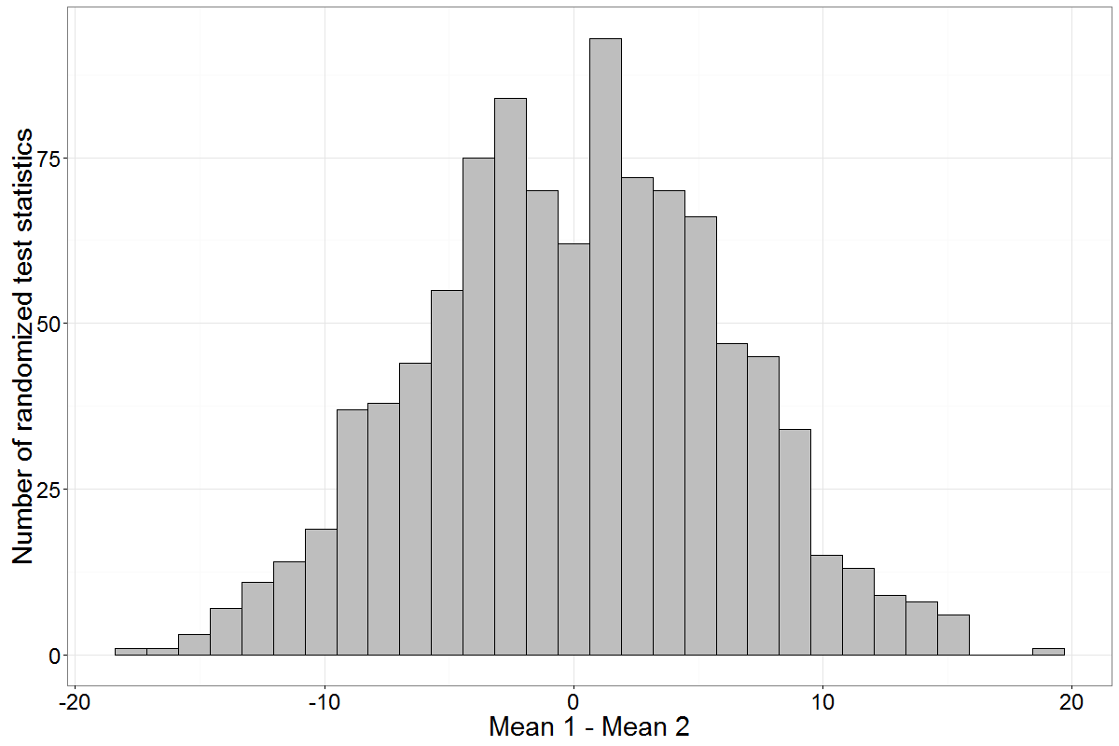
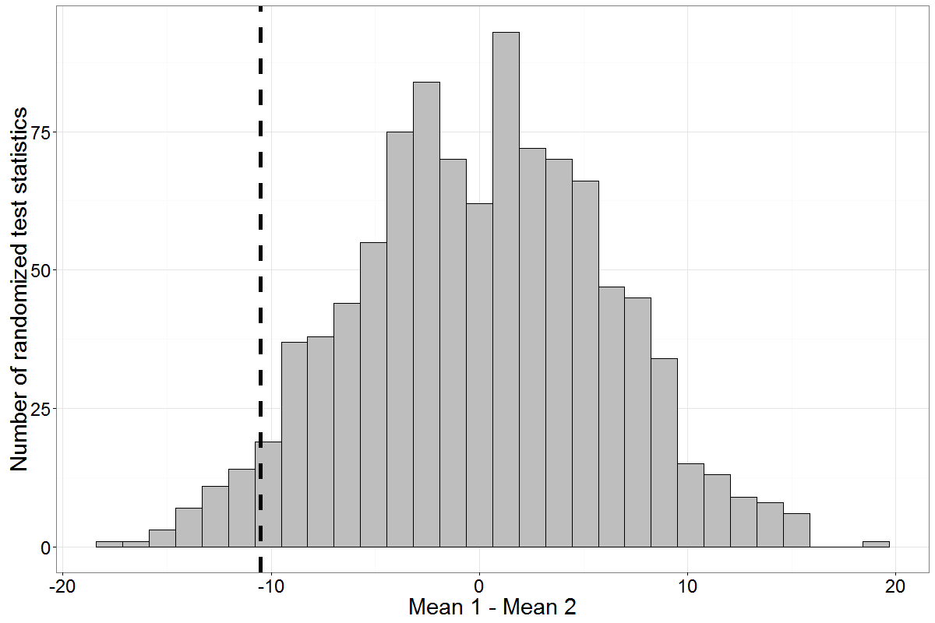
For a one-sided test, calculate the proportion of randomized test statistics less than the observed difference between the real datasets.
P-value = 0.04
…
…
…
Real data

Slide 5
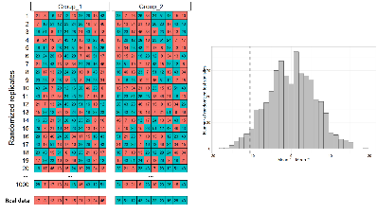
Repeat randomization process 1000 times
Calculate power as the proportion of tests that a significant difference between the treatment means was observed.

Slide 6
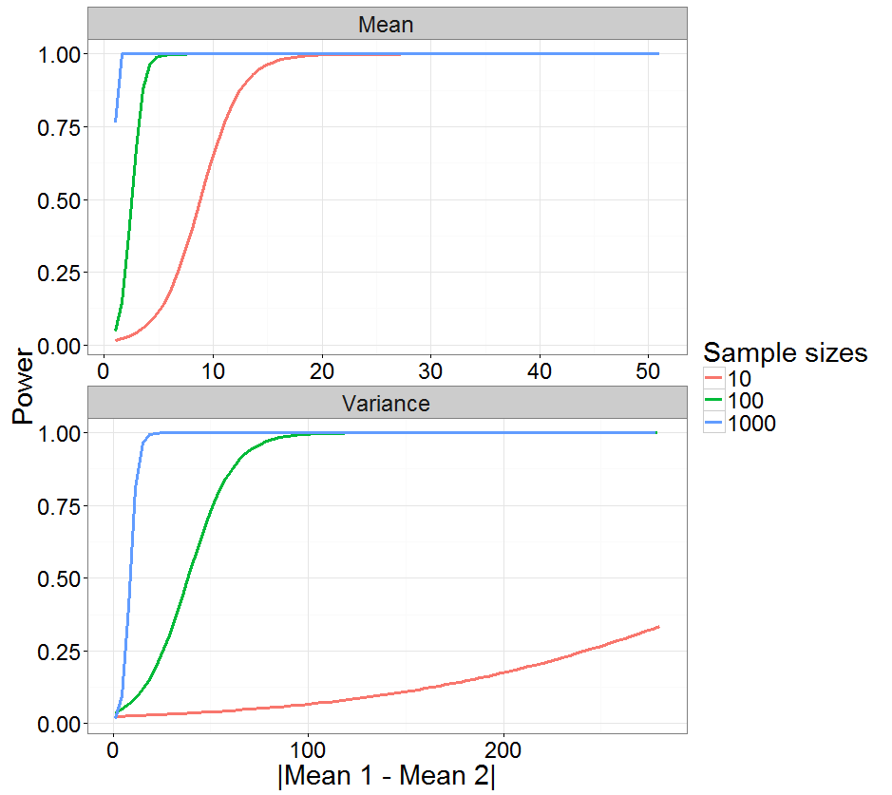

Slide 7
Repeat randomization process 1000 times

Slide 8
Result: Created a distribution of the randomized expectations.
…
…
…
Real data

Slide 9
…
…
…
Real data

